Slide 1
BTEC Level 2 TRAVEL AND TOURISM
Applied GCSE

Slide 2
What is TRAVEL AND TOURISM?
Travel and Tourism is a course designed to give you an understanding of the fasting growing Employment sector in the Economy
Travel and Tourism can give you life skill which may help you to have a Career in the Travel and Tourism sector in the Future

Slide 3
Are there Opportunities in Travel and Tourism?

Slide 4
What does the course involve?

Slide 5
The UK Travel and Tourism Sector One Exam Unit

Slide 6
Marking is Merit and Distinction
Awarded as:
Merit
Or
Distinction

Slide 7
Unit 1

Slide 8
Unit 2

Slide 9
Unit 3

Slide 10
Unit 5 and 4 are optional

Slide 11
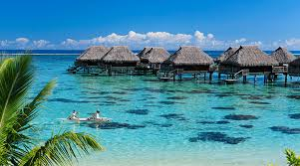
What are the Career options
Waitress Lifeguard
Ski Instructor Accountant
Tour Bus Driver Tour Guides
Hotel Assistant Swimming Coach
Ferry Drivers Shop Assistants
Ranger for National Park Surf Instructor
Driver Restaurant Worker
Pilot Travel Agent
Hotel Manager Transport Manager
Translator Event Coordinator
Theme Park Operator

Slide 12
Organisations Involved in Travel and Tourism

Slide 13
In Order to be accepted to Study Travel and Tourism you must be recommended by your Geography Teacher

Slide 14
Find out more from this video on Youtube
https://www.youtube.com/watch?v=rcJHfSrCZg8

